Slide 1
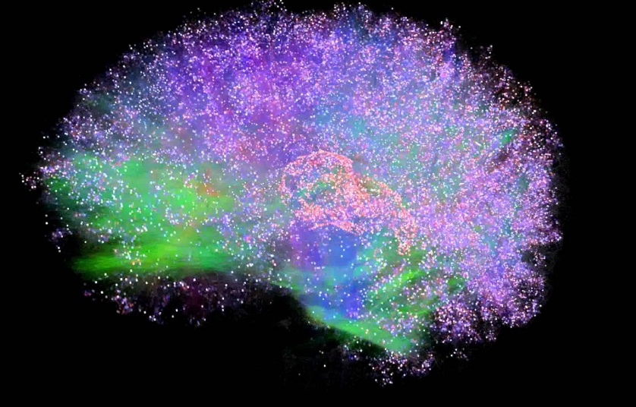
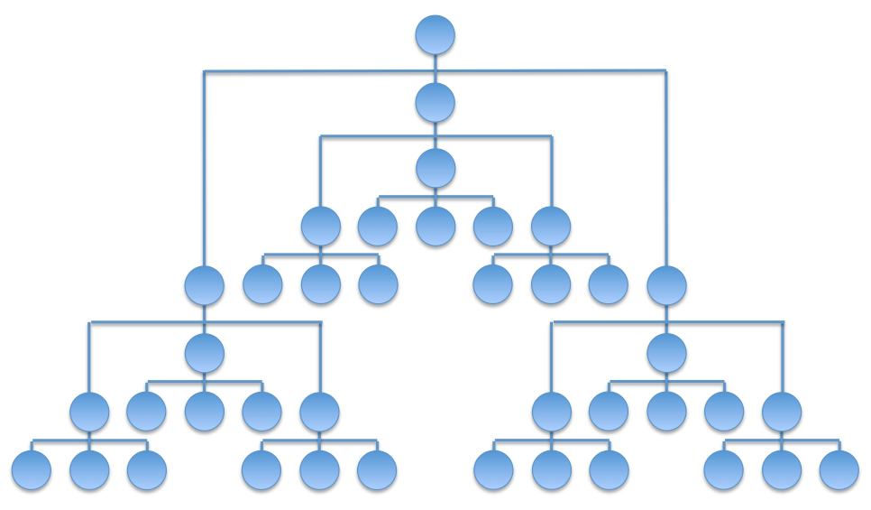
Integrated Information Theory for Organisational Consciousness
Jonathan Peters
Supervisors: Mariano Berguisse, Christian Bick, Yakov Kremnitzer, Steve Brewis, Steve Cassidy

